Slide 1
Bài 5: Phân tích cú pháp phụ thuộc
Lê Thanh Hương
School of Information and Communication Technology, HUST

Slide 2
Thông tin giảng viên
Phd Nguyen Kiem Hieu
Computer science department, School of Information and Communication Technology, HUST
Email: hieunk@soict.hust.edu.vn

Slide 3
Content
Overview
Introduction
Applications
Properties
Approaches
Transition-based
Graph-based
Current approaches
Some results
3

Slide 4
Introduction
Increasing interest in dependency-based approaches to syntactic parsing in recent years
Dependency-based methods still less accessible for the majority of researchers and developers than the more widely known constituency-based methods
4

Slide 5
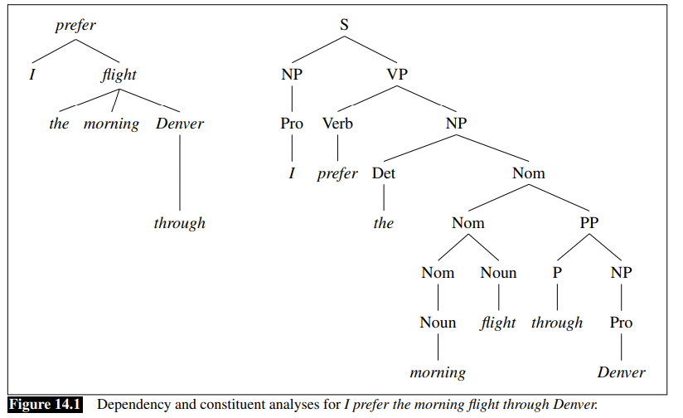
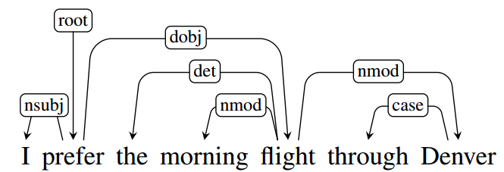
Dan Jurafsky and James Martin. Speech and Language Processing. PrenticeHall (3rd draft)
5
Notes:
Syntactic tree of the input string that has been parsed following context free grammar. Analyze the syntactic role of each phrase in the sentence: NP, VP.
Syntactic tree of the input string that has been parsed following dependency grammar. Analyze the dependency relations between words in the sentence

Slide 6
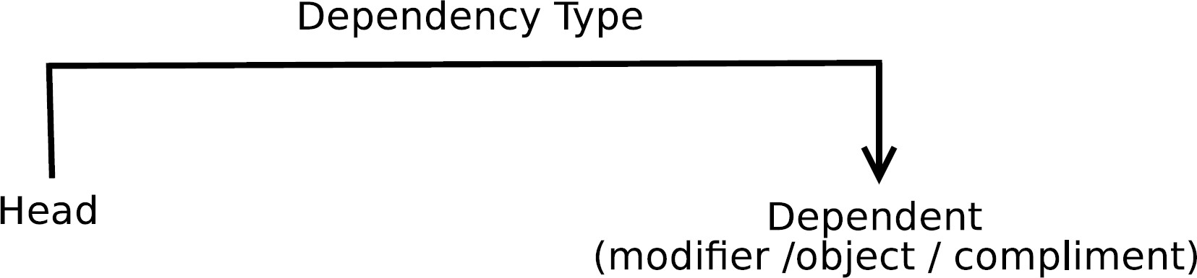
Dependency Grammars
Syntactic structure = lexical items linked by binary asymmetrical relations called dependencies

Slide 7
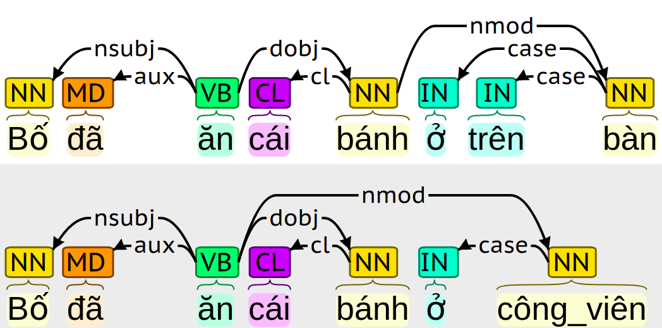
Example Dependency Parse
7
Notes:
câu trên, 'bàn' bổ nghĩa cho 'bánh', thể hiện vị trí cái bánh.
câu dưới 'công_viên' bổ nghĩa cho 'ăn', thể hiện vị trí hành động ăn.

Slide 8
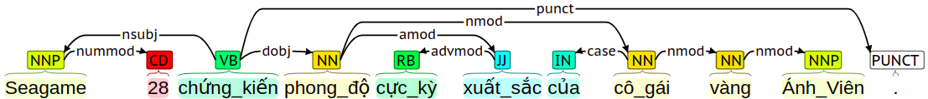
Some dependency labels
nsubj (Nominal subject): chủ ngữ, chủ thể
dobj (Direct object): tân ngữ trực tiếp
nmod (Nominal modifier): danh từ bổ nghĩa
amod (Adjectival modifier): tính từ bổ nghĩa
nummod (Numeric modifier): số từ bổ nghĩa
case (dependent of the noun they attach to or introduce)
8

Slide 9
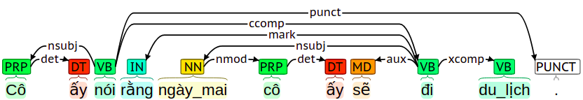
Some dependency labels
ccomp (Clausal component): Mệnh đề thành phần
xcomp (Open clausal component): Mệnh đề thành phần mở rộng
aux (Auxiliary): phụ từ, trợ động từ
See more: http://universaldependencies.org/u/dep/
9

Slide 10
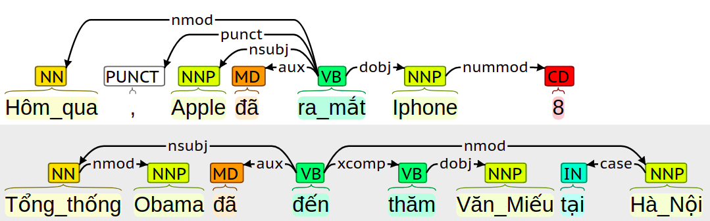
Applications
Building a knowledge base using relation extraction
(Apple, ra mắt, Iphone 8) (Obama, thăm, Văn Miếu) (Văn Miếu, tại, Hà Nội)
10
Notes:
(Apple, ra_mắt, Iphone 8)
(Obama, đến, Văn Miếu)

Slide 11
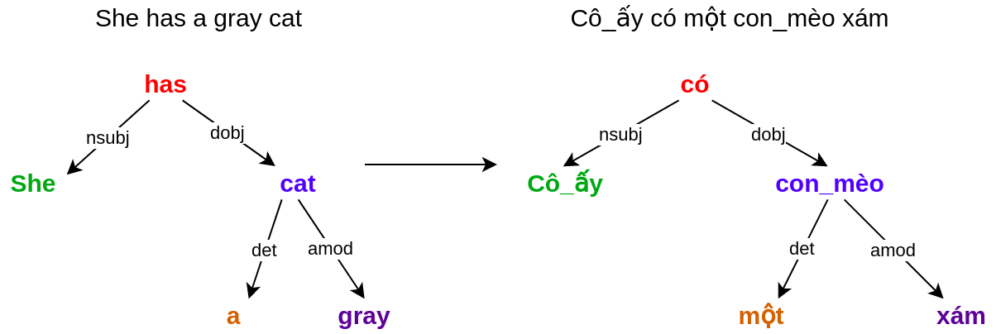
Applications
Machine Translation
11

Slide 12
Properties
General form: a graph G = (V,A)
V vertices: usually one per word in sentence
A arcs (set of ordered pairs of vertices): head-dependent relations between elements in V
Notational conventions (i , j ∈ V ):
i → j ≡ (i , j ) ∈ E
i →∗ j ≡ i = j ∨ ∃k : i → k, k →∗ j
12

Slide 13
Properties
Weakly Connected
For every node i there is a node j such that i → j or j → i .
Acyclic:
If i → j then not j →∗ i .
Single head:
If i → j , then not k → j , for any k != i .
13

Slide 14
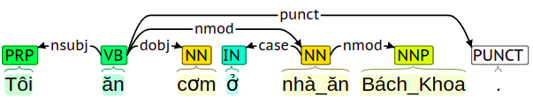
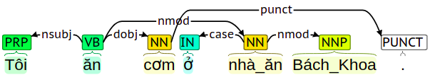
Properties
Projective: There are no crossing dependencies
Projective
Non-Projective
14

Slide 15
Content
Overview
Introduction
Applications
Properties
Approaches
Transition-based
Graph-based
Current approaches
Some results
15

Slide 16
Approaches
Transition-based
Nivre algorithm
Graph-based
Current approaches
End to end learning
Joint learning
16

Slide 17
Transition-based
Main idea is to base on Transitions (SHIFT, REDUCE, LEFT-ARC, RIGHT-ARC)
When reading a sentence from left to right, the learning model will decide which transition to perform. This sequence of transitions helps to determine the dependency relationship between the words in the sentence.
Need training this model
17

Slide 18
Transition-based
Parsing algorithm: Nivre, Covington, ...
Classifying method: SVM, Neural network, ...
18

Slide 19
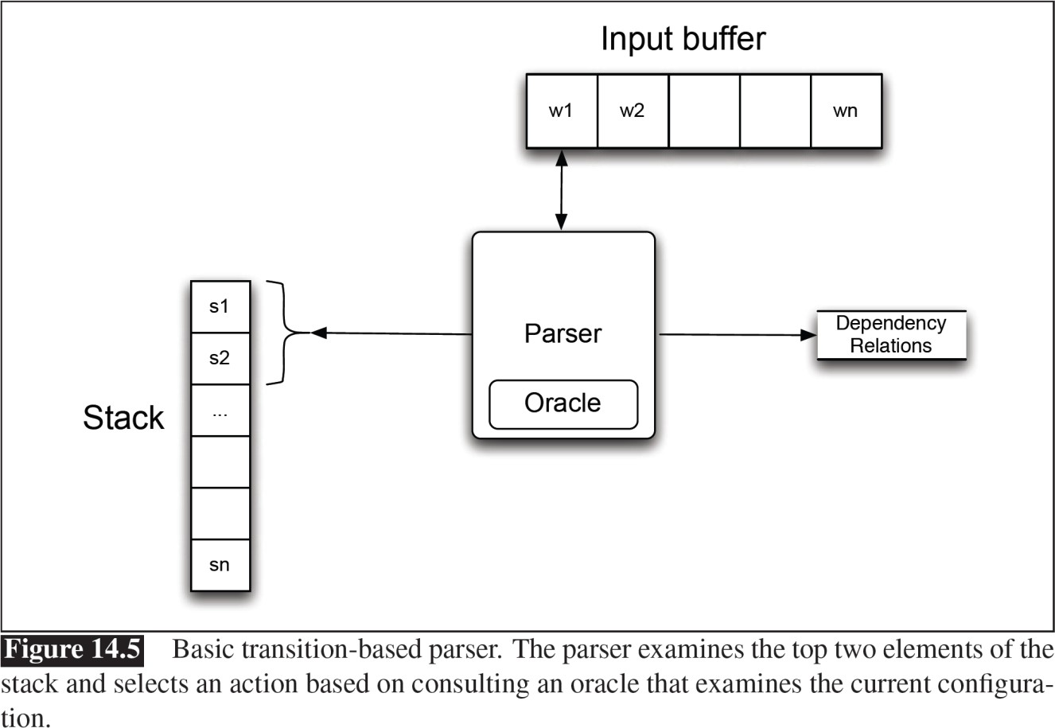
Nivre algorithm
Given: c = (𝚺|s, b|B, A), in which
Stack 𝚺 stores partially processed tokens
Buffer B stores unread tokens.
Set A stores dependent relations being found
Transition bases on the current configuration to go to the new configuration, also including these 3 members
19

Slide 20
Nivre algorithm
4 transition:
SHIFT [(𝚺, b|B, A)] = (𝚺|b, B, A)
RIGHT_{lb} [(𝚺|s, b|B, A)] = (𝚺|s|b, B, A ∪ {s, lb, b})
LEFT_{lb} [(𝚺|s, b|B, A)] = (𝚺, b|B, A ∪ {b, lb, s})
REDUCE [(𝚺|s, B, A)] = (𝚺, B, A)
Description:
SHIFT: Remove the top word of the buffer and push it onto the stack.
RIGHT: Insert the top word of the buffer to the stack, add relation (s, lb, b) to A
LEFT: pop the stack, add relation (b, lb, s) to A
REDUCE: Pop the stack
20

Slide 21
Parsing Methods
Example
[root]_{S} [Economic news had little effect on financial markets .]_{Q}
57(103)

Slide 22
Parsing Methods
Example
[root Economic]_{S} [news had little effect on financial markets .]_{Q}
Shift
57(103)

Slide 23
Example
Parsing Methods
nmod
[root]_{S} Economic [news had little effect on financial markets .]_{Q} Left-Arc_{nmod}

Slide 24
Example
Parsing Methods
nmod
[root Economic news]_{S} [had little effect on financial markets .]_{Q} Shift
57(103)

Slide 25
Example
Parsing Methods
nmod
sbj
[root]_{S} Economic news [had little effect on financial markets .]_{Q}
Left-Arc_{sbj}
57(103)

Slide 26
Example
Parsing Methods
pred
nmod
sbj
[root Economic news had]_{S} [little effect on financial markets .]_{Q}
Right-Arc_{pred}
57(103)

Slide 27
Example
Parsing Methods
pred
nmod
sbj
[root Economic news had little]_{S} [effect on financial markets .]_{Q}
Shift
57(103)

Slide 28
Example
Parsing Methods
pred
nmod
sbj
nmod
[root Economic news had]_{S} little [effect on financial markets .]_{Q}
Left-Arc_{nmod}
57(103)

Slide 29
Example
Parsing Methods
pred
obj
nmod
sbj
nmod
[root Economic news had little effect]_{S} [on financial markets .]_{Q}
Right-Arc_{obj}
57(103)

Slide 30
Example
Parsing Methods
pred
obj
nmod
sbj
nmod
nmod
[root Economic news had little effect on]_{S} [financial markets .]_{Q}
Right-Arc_{nmod}
57(103)

Slide 31
Example
Parsing Methods
pred
obj
nmod
sbj
nmod
nmod
[root Economic news had little effect on financial]_{S} [markets .]_{Q}
Shift
57(103)

Slide 32
Example
Parsing Methods
pred
obj
nmod
sbj
nmod
nmod
nmod
[root Economic news had little effect on]_{S} financial [markets .]_{Q}
Left-Arc_{nmod}
57(103)

Slide 33
Example
Parsing Methods
pred
obj
pc
nmod
sbj
nmod
nmod
nmod
[root Economic news had little effect on financial markets]_{S} [.]_{Q}
Right-Arc_{pc}
57(103)

Slide 34
Example
Parsing Methods
pred
obj
pc
nmod
sbj
nmod
nmod
nmod
[root Economic news had little effect on]_{S} financial markets [.]_{Q}
Reduce
57(103)

Slide 35
Example
Parsing Methods
pred
obj
pc
nmod
sbj
nmod
nmod
nmod
[root Economic news had little effect]_{S} on financial markets [.]_{Q}
Reduce
57(103)

Slide 36
Example
Parsing Methods
pred
obj
pc
nmod
sbj
nmod
nmod
nmod
[root Economic news had]_{S} little effect on financial markets [.]_{Q}
Reduce
57(103)

Slide 37
Example
Parsing Methods
pred
obj
pc
nmod
sbj
nmod
nmod
nmod
[root]_{S} Economic news had little effect on financial markets [.]_{Q}
Reduce
57(103)

Slide 38
Example
Parsing Methods
p
pred
obj
pc
nmod
sbj
nmod
nmod
nmod
[root Economic news had little effect on financial markets .]_{S} []_{Q}
Right-Arc_{p}
57(103)

Slide 39
Nivre algorithm
Input sentence W = w₁, w₂, ..., w_{n}. (w_{i} is the word i^{th} in the sentence)
Initial configuration: c_{init} = (𝚺, B, A)
𝚺 = {ROOT}
B: B = w₁, w₂, ..., w_{n}
A: {}
Terminal configuration: c_{terminal} = (𝚺, B, A)
𝚺: {ROOT}
B: {}
A: set of dependent relations.
39

Slide 40

Example
Input sentence: Tôi ăn cơm ở Bách_Khoa .
Stack: [
Buffer: ]
A : {}
Active: the node is being considered
Deleted: the node is completely visited, remove from Stack
40

Slide 41

Example
SHIFT: move 'Tôi' from Buffer to Stack
A = {}
41

Slide 42

Example
LEFT_{nsubj}: Delete 'Tôi' from Stack, add (ăn, nsubj, Tôi) into A
A= {(ăn, nsubj, Tôi)}
42

Slide 43
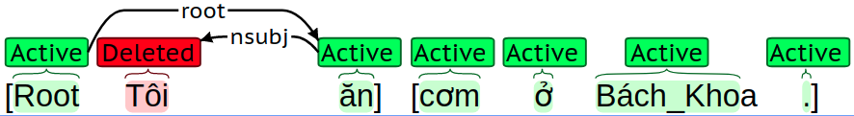
Example
RIGHT_{root}: Add 'ăn' from bufer to stack, add (Root, root, ăn) to A
A= {(ăn, nsubj, Tôi), (Root, root, ăn)}
43

Slide 44
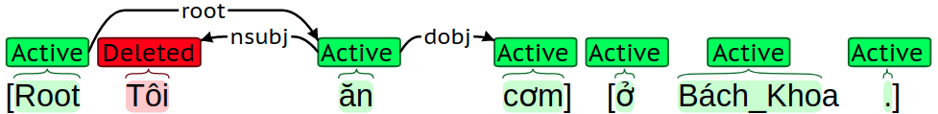
Example
RIGHT_{dobj}: Add 'cơm' from buffer to stack, add (ăn, dobj, cơm) to A
A= {(ăn, nsubj, Tôi), (Root, root, ăn), (ăn, dobj, cơm) }
44

Slide 45
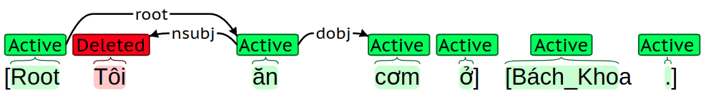
Example
SHIFT: move 'ở' from buffer to stack
A= {(ăn, nsubj, Tôi), (Root, root, ăn), (ăn, dobj, cơm) }
45

Slide 46
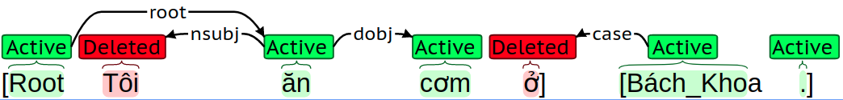
Example
LEFT_{case}: Remove 'ở' from Stack, add (Bách_Khoa, case, ở) to A
A= {(ăn, nsubj, Tôi), (Root, root, ăn), (ăn, dobj, cơm), (Bách_Khoa, case, ở) }
46

Slide 47
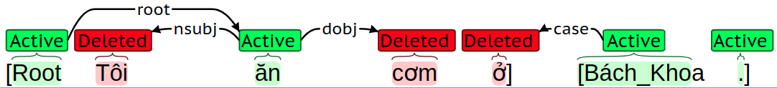
Example
REDUCE: REmove 'cơm' from Stack
A= {(ăn, nsubj, Tôi), (Root, root, ăn), (ăn, dobj, cơm), (Bách_Khoa, case, ở) }
47

Slide 48
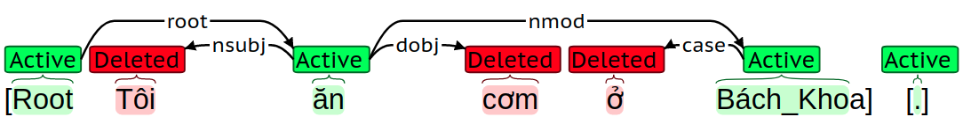
Example
RIGHT_{nmod}: Add 'Bách_Khoa' from buffer to stack, add (ăn, nmod, Bách_Khoa) to A
A= {(ăn, nsubj, Tôi), (Root, root, ăn), (ăn, dobj, cơm), (Bách_Khoa, case, ở), (ăn, nmod, Bách_Khoa) }
48

Slide 49
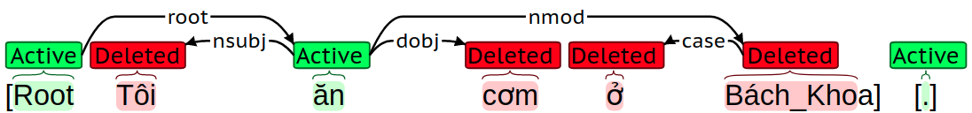
Example
REDUCE: Remove 'Bách_Khoa' from Stack
A= {(ăn, nsubj, Tôi), (Root, root, ăn), (ăn, dobj, cơm), (Bách_Khoa, case, ở), (ăn, nmod, Bách_Khoa) }
49

Slide 50
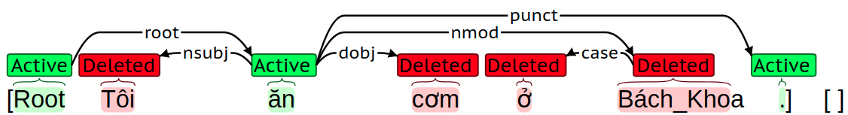
Example
RIGHT_{punct}: Add '.' from buffer to stack, add (ăn, punct, .) to A
A= {(ăn, nsubj, Tôi), (Root, root, ăn), (ăn, dobj, cơm), (Bách_Khoa, case, ở), (ăn, nmod, Bách_Khoa), (ăn, punct, .) }
50

Slide 51
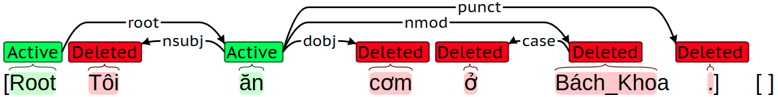
Example
REDUCE: Remove '.' from Stack
A= {(ăn, nsubj, Tôi), (Root, root, ăn), (ăn, dobj, cơm), (Bách_Khoa, case, ở), (ăn, nmod, Bách_Khoa), (ăn, punct, .) }
51

Slide 52
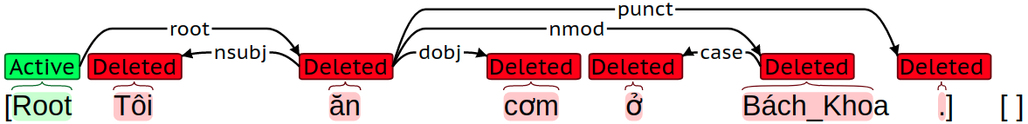
Example
REDUCE: Remove 'ăn' from Stack
Now is the final configuration, Stack = {Root}, Buffer ={}. Return A
52

Slide 53
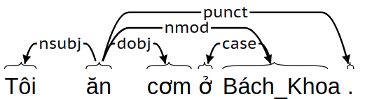
Example
Final tree
53

Slide 54
Approaches
Transition-based
Nivre algorithm
Graph-based
Current approaches
End to end learning
Joint learning
54

Slide 55
Graph-based Dependency Parsing
Goal: Find the highest scoring dependency tree T for sentence S
If S is unambiguous, T is the correct parse.
If S is ambiguous, T is the highest scoring parse.
Where do scores come from?
Weights on dependency edges by machine learning
Learned from large dependency treebank
Where are the grammar rules?
Data-driven processing

Slide 56
Graph-based Dependency Parsing
Map dependency parsing to maximum spanning tree
Idea:
Build initial graph: fully connected
Nodes: words in sentence to parse
Edges: Directed edges between all words
+ Edges from ROOT to all words
Identify maximum spanning tree
Tree s.t. all nodes are connected
Select such tree with highest weight
Arc-factored model: Weights depend on end nodes & link
Weight of tree is sum of participating arcs

Slide 57
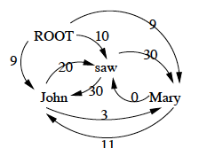
Initial Tree
Sentence: John saw Mary (McDonald et al, 2005)
All words connected; ROOT only has outgoing arcs
Goal: Remove arcs to create a tree covering all words
Resulting tree is dependency parse

Slide 58
Maximum Spanning Tree
McDonald et al, 2005 use variant of Chu-Liu-Edmonds algorithm for MST (CLE)
Sketch of algorithm:
For each node, greedily select incoming arc with max w
If the resulting set of arcs forms a tree, this is the MST.
If not, there must be a cycle.
“Contract” the cycle: Treat it as a single vertex
Recalculate weights into/out of the new vertex
Recursively do MST algorithm on resulting graph
Running time: naïve: O(n³); Tarjan: O(n²)
Applicable to non-projective graphs

Slide 59
Initial Tree

Slide 60
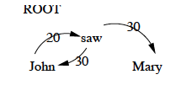
CLE: Step 1
Find maximum incoming arcs
Is the result a tree?
No
Is there a cycle?
Yes, John/saw

Slide 61
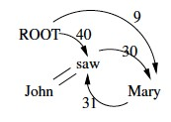
CLE: Step 2
Since there’s a cycle:
Contract cycle & reweight
John+saw as single vertex
Calculate weights in & out as:
Maximum based on internal arcs
and original nodes
Recurse

Slide 62
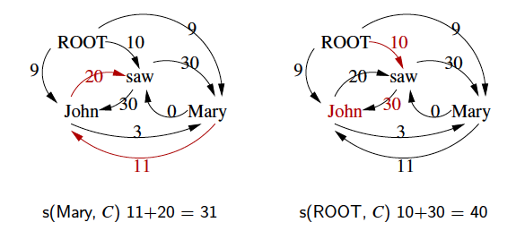
Calculating Graph

Slide 63
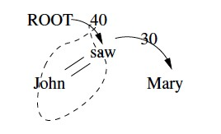
CLE: Recursive Step
In new graph, find graph of
Max weight incoming arc for each word
Is it a tree? Yes!
MST, but must recover internal arcs → parse

Slide 64
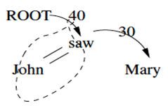
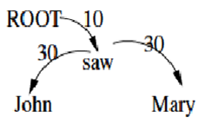
CLE: Recovering Graph
Found maximum spanning tree
Need to ‘pop’ collapsed nodes
Expand “ROOT → John+saw” = 40
MST and complete dependency parse

Slide 65
Learning Weights
Weights for arc-factored model learned from corpus
Weights learned for tuple (w_{i},w_{j},l)
McDonald et al, 2005 employed discriminative ML
Perceptron algorithm or large margin variant
Operates on vector of local features

Slide 66
Features for Learning Weights
Simple categorical features for (w_{i},L,w_{j}) including:
Identity of w_{i} (or char 5-gram prefix), POS of w_{i}
Identity of w_{j} (or char 5-gram prefix), POS of w_{j}
Label of L, direction of L
Sequence of POS tags b/t w_{i},w_{j}
Number of words b/t w_{i},w_{j}
POS tag of w_{i-1},POS tag of w_{i+1}
POS tag of w_{j-1}, POS tag of w_{j+1}
Features conjoined with direction of attachment and distance b/t words

Slide 67
Dependency Parsing
Dependency grammars:
Compactly represent pred-arg structure
Lexicalized, localized
Natural handling of flexible word order
Dependency parsing:
Conversion to phrase structure trees
Graph-based parsing (MST), efficient non-proj O(n²)
Transition-based parser
MALTparser: very efficient O(n)
Optimizes local decisions based on many rich features

Slide 68
Approaches
Transition-based
Nivre algorithm
Graph-based
Current approaches
End to end learning
Joint learning
68

Slide 69
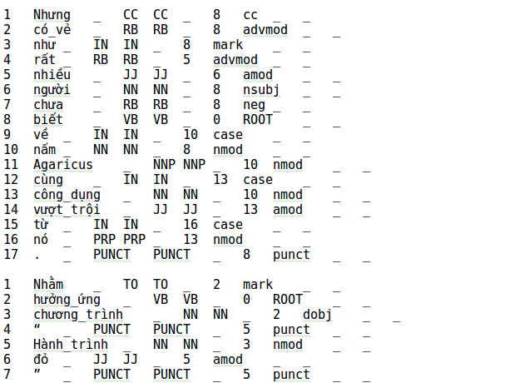
End-to-end Learning
Training data: CoNLL Format.
Labelled information:
id
word
POS tag
Head’s id
Dependency labels
69

Slide 70
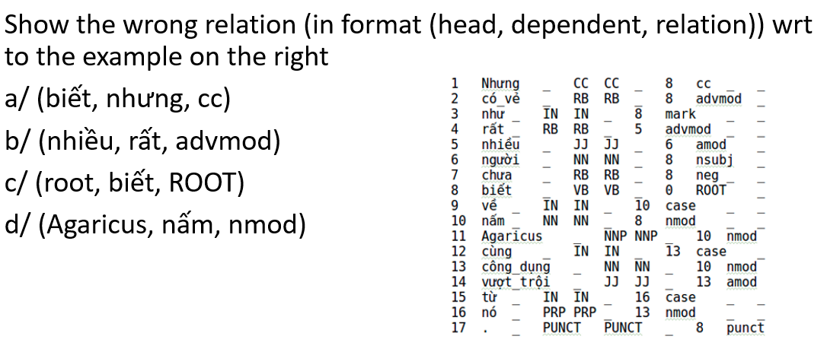
Question

Slide 71
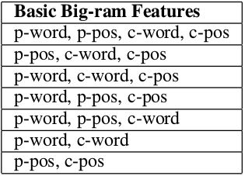
End-to-end Learning
Manually choosing features:
Need experts
#feature template is large due to the feature combination
=> Maybe the highest cost for solving this task.
71
Notes:
Nói về số lượng các Feature lựa chọn ra được

Slide 72
End-to-end Learning
End to end learning for solving this task:
Idea: training in parallel 2 modules: feature extractor and classifier
Don’t need to choose features manually
72

Slide 73
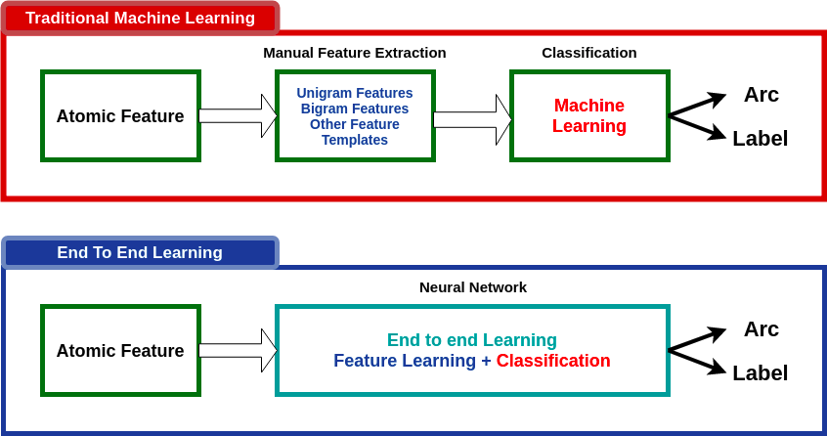
End-to-end Learning
73

Slide 74
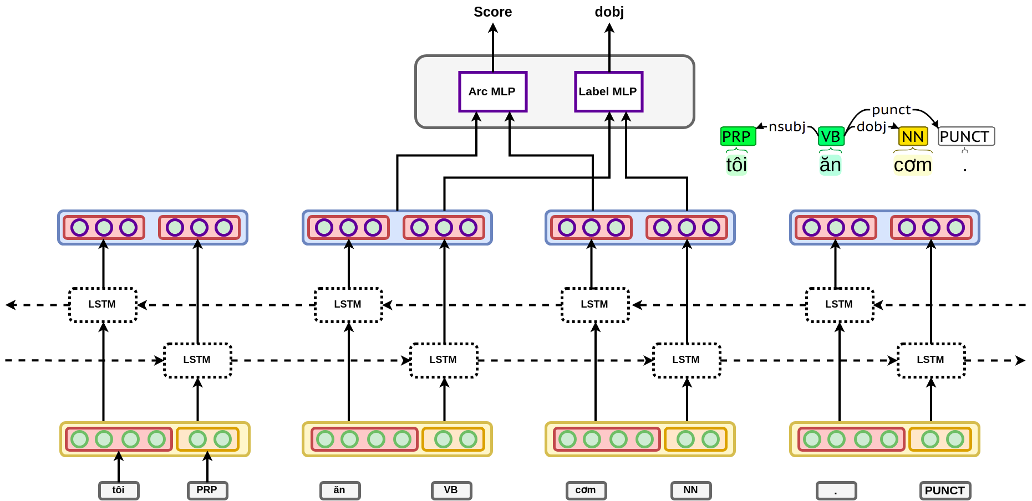
End-to-end
74

Slide 75
Joint Learning
Learning in parallel multi-tasks :
The learning tasks need to be related
Joint learning has many advantages: the shared parts contain information of several tasks, reducing model’s overfitting
2 joint learning tasks in dependency parsing: POS Tagging + Dependency Parsing.
75

Slide 76
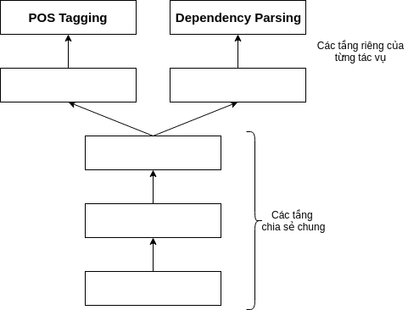
Joint Learning
In the figure:
2 tasks: POS tagging and Dependency Parsing share input neural layers.
The output of the share input layers is used as the input for each task.
Recent research use BiLSTMs as input neural layers
76

Slide 77
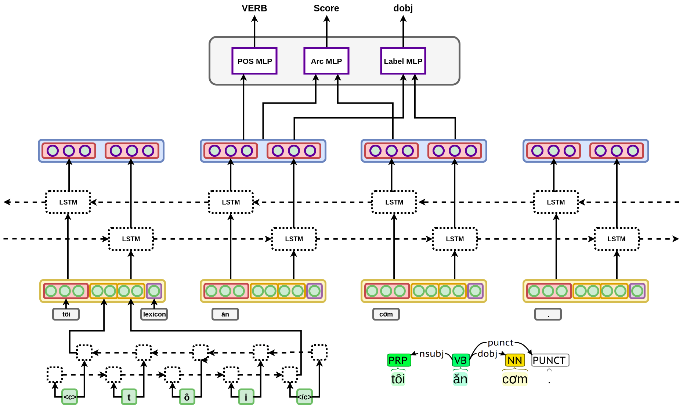
Joint Learning
77

Slide 78
Joint Learning
An RNN is used to generate word embedding
BiLSTM generates input representation for MLP networks of POS Tagging and Dependency Parsing tasks (from vector containing information of characters, words, POS tags)
78

Slide 79
Joint Learning
2 joint learning tasks:
POS tagging
Computing edge weights (dependent relations connecting word pairs)
Determining dependent labels between each word pairs.
79

Slide 80
Content
Overview
Introduction
Applications
Properties
Approaches
Transition-based
Graph-based
Current approaches
Some results
80

Slide 81
Some results
POS Tagging
Dependency Parsing
Dataset
Experimental Results
81

Slide 82
POS Tagging
CRFSuite
jPTDP: tool for joint learning, using Neural Network, joint learns POS Tagging and Dependency Parsing.
82

Slide 83
Dependency Parsing.
Malt Parser (Transition based):
Dependency parser: Nivre
Learning method: SVM
Yara Parser (Transition based):
Dependency parser: Nivre
Learning method: Neural Network
Improvement: Error Exploration, Beam Search
BiLSTM Transition-based:
Dependency parser: Nivre
Learning method: Neural Network
End to end learning
83

Slide 84
Dependency Parsing.
BiLSTM Graph-based:
Dependency parser: Eisner
Learning method: Neural Network
End to end learning
jPTDP (Graph-based):
Dependency parser: Eisner
Learning method: Neural Network
End to end learning
Joint Learning POS Tagging + Dependency Parsing
84

Slide 85
Dataset
Dataset: BK Treebank.
6908 sentences in CoNLL-U Format
4505 sentences for training, 1134 sentences for development, 1269 sentences for testing
Evaluating measures:
POS Tagging: Accuracy.
Dependency Parsing: UAS and LAS
UAS: Unlabeled Attachment Score
LAS: Labeled Attachment Score
85

Slide 86
Results
Methods | UAS | LAS
Malt Parser | 84.4 % | 81.4 %
Yara Parser | 86.3 % | 83.4 %
BiLSTM Transition | 86.4 % | 82.9 %
BiLSTM Graph | 87 % | 84.2%
The input text has been assigned with POS tags.
86

Slide 87
Results
Method | POS Accuracy | UAS | LAS
CRF + Malt Parser | 90.66 % | 76.7 % | 70.2 %
CRF + Yara Parser | 90.66 % | 79.1 % | 72.6 %
CRF + BiLSTM Transition | 90.66 % | 78.9 % | 72.2 %
CRF + BiLSTM Graph | 90.66 % | 79.7 % | 73 %
jPTDP | 89.16 % | 80.4 % | 73 %
The input text has not been assigned with POS tags.
87

Slide 88
Result
Method | POS Accuracy | UAS | LAS
jPTDP | 89.16 % | 80.4 % | 73 %
jPTDP + Lexicon | 91.50 % | 82.13 % | 75.67 %
jPTDP + Lexicon (Not Character Embed) | 91.05% | 81.46 % | 75.23 %
The input text has not been assigned with POS tags.
88

Slide 89
References
[1] Kiem-Hieu Nguyen. BKTreebank: Building a Vietnamese Dependency Treebank
[2] Yue Zhang and Joakim Nivre. Training Deterministic Parsers with Non-Deterministic Oracles
[3] Eliyahu Kiperwasser and Yoav Goldberg. Simple and Accurate Dependency Parsing Using Bidirectional LSTM Feature Representations
[4] Dat Quoc Nguyen, Mark Dras and Mark Johnson. A Novel Neural Network Model for Joint POS Tagging and Graph-based Dependency Parsing
89

Slide 90
Tài liệu tham khảo.
[5] Yuan Zhang and David Weiss. Stack-propagation: Improved Representation Learning for Syntax
[6] Barbara Plank, Anders Søgaard, Yoav Goldberg. Multilingual Part-of-Speech Tagging with Bidirectional Long Short-Term Memory Models and Auxiliary Loss
[7] Ryan McDonald et al. Online Large-Margin Training of Dependency Parsers
[8] Yoav Goldberg and Joakim Nivre. Training Deterministic Parsers with Non-Deterministic Oracles
90

